Slide 1

BUS PASS MANAGAMENT SYSTEM

Slide 2

PREPARED BY:
TEAM QUANTI5
M.NISHITH
P.B.S SREENIDHY
T.BHARGAV
K.U NIKITHA
P.MANI PREETHAM

Slide 3

AGENDA
PROJECT SCOPE
TECHNOLOGIES USED
ABSTRACT
PROS
OVER VIEW
CONCLUSION

Slide 4

PROJECT SCOPE
BUS PASS MANAGEMENT PROJECT IN PHP IS A WEB-BASED TECHNOLOGY THAT WILL MANAGE THE RECORDS OF THE PASS WHICH IS ISSUE BY ADMINISTRATIVE AND ALSO HELP TO PROVIDE ONLINE BUS PASS TO PEOPLE WHO NEED TO TRAVEL DAILY. BUS PASS MANAGEMENT SYSTEM PROJECT IS HELPFUL TO BUS ADMINISTRATION BY REDUCING THE PAPERWORK, TIME CONSUMPTION AND MAKES THE PROCESS OF GETTING BUS PASSES AS SIMPLE AND FAST.

Slide 5

TECHNOLOGIES USED
Language Used | PHP5.6, PHP7.x
Database | MySQL 5.x
User Interface Design | HTML, AJAX,JQUERY,JAVASCRIPT
Web Browser | Mozilla, Google Chrome, IE8, OPERA
Software | XAMPP / Wamp / Mamp/ Lamp (anyone)

Slide 6

ABSTRACT
THE SYSTEM IS INTENDED TO DEVELOP AN APPLICATION TO PERFORM FUNCTIONS LIKE ACCESSING BASIC INFORMATION FOR AUTHENTICATION AND PROVIDE PASSES WITHOUT THE NEED TO WAIT IN ANY QUEUE.

Slide 7

PROS
NO QUEUE
DIGITAL BUS PASS
CAN BE ACCESSED ANYWHERE
UNIQUE ID FOR EACH PASS WHICH CAN AVOID DUPLICATION OF PASSES
IDENTIFICATION OF FAKE USER
EASY PAYMENT
SAVES TIME,AFFORDABLE AND COMFORTABLE

Slide 8
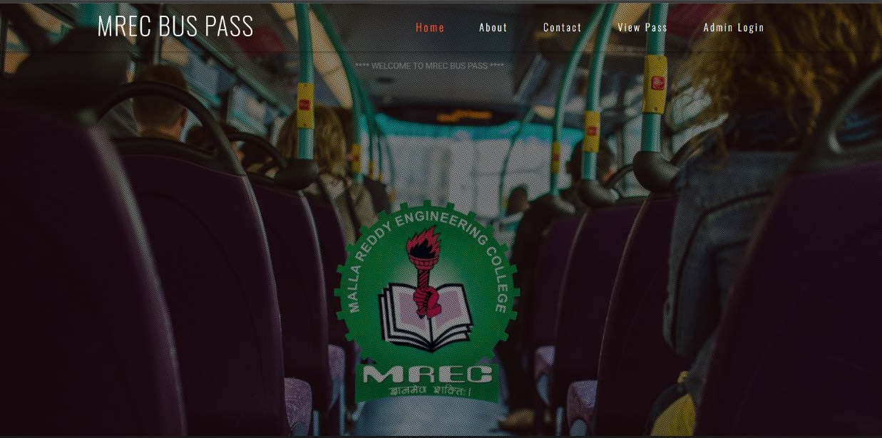

Slide 9
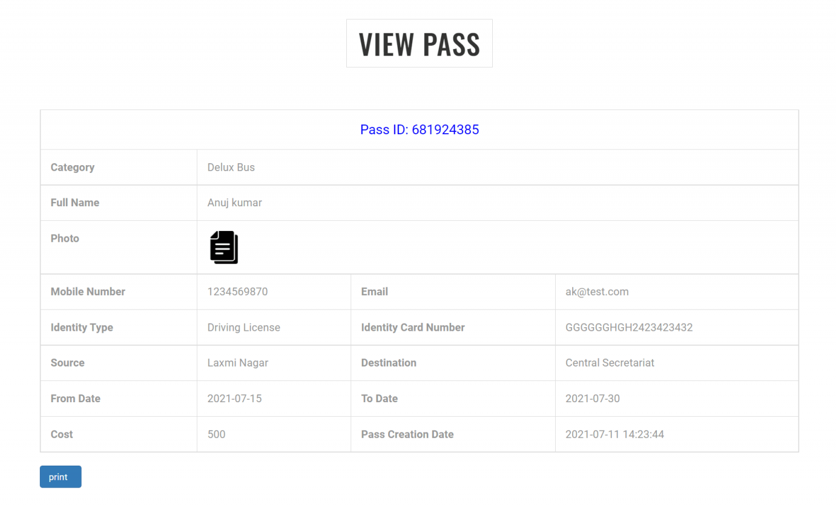

Slide 10
CONCLUSION
STUDENTS CAN DIRECTLY APPLY FOR BUS PASS THROUGH ONLINE
BUS PASS CAN BE ACCESSED IN DIGITAL FORMAT.
BUS FEE PAYMENT CAN BE DONE THROUGH THE PORTAL ITSELF USING VARIOUS PAYMENT METHODS.
UNIQUE PASS ID FOR EACH STUDENT WHICH HELPS IN IDENTIFYING THE FAKE USERS.

Slide 11
THANK YOU

